Slide 1
Power Monitoring Chip
Ka Fung, Lucas Crandall, Pak Lam Yung, Gabriel Unger
Summer 2012
Professor Thomas Jones

Slide 2

MAXQ3183
The MAXQ3183 chip (slave) interfaces with Arduino (master) through SPI (Serial Peripheral Interface)
The 3183 chip continuously samples voltage and current
The chip’s ADC calculates RMS voltage, current, power, harmonic contributions, etc… and store the values into virtual registers
All interactions with the chip involves writing and reading from registers

Slide 3
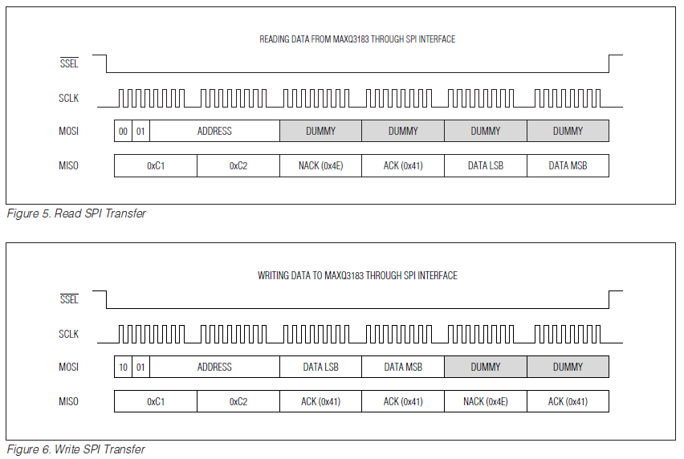
SPI

Slide 4
Registers
Voltages (RMS) | In Volts | In Metering Units |  | Real Power | In Watts |  | Real Energy | In Joules
A | 831 | 1C8 |  | A | 801 |  | A | 8C1
B | 832 | 2B4 |  | B | 802 |  | B | 8C2
C | 834 | 3A0 |  | C | 804 |  | C | 8C4
Harmonics | 830 | ? |  | Total | 807 |  | Total | 8C7
Currents (RMS) | In Amps | In Metering Units |  | Reactive Power | In VAR |  | Reactive Energy | In Joules
A | 841 | 1CC |  | A | 811 |  | A | 8D1
B | 842 | 2B8 |  | B | 812 |  | B | 8D2
C | 844 | 3A4 |  | C | 814 |  | C | 8D4
Harmonics | 840 | ? |  | Total | 817 |  | Total | 8D7
Harmonic / Auxilliary Channel Register |  |  |  | Apparent Power | In VA |  | Apparent Energy | In Joules
010 |  |  |  | A | 821 |  | A | 871
 |  |  |  | B | 822 |  | B | 872
 |  |  |  | C | 824 |  | C | 874
 |  |  |  | Total | 827 |  | Total | 877
Calibration
Voltages |  |  | Currents |  |  | Power
Gain A | 132 |  | Gain A | 130 |  | Conversion | 018
Gain B | 21E |  | Gain B | 21C
Gain C | 30A |  | Gain C | 308
Conversion | 014 |  | Gain N | 12E
 |  |  | Conversion | 016

Slide 5
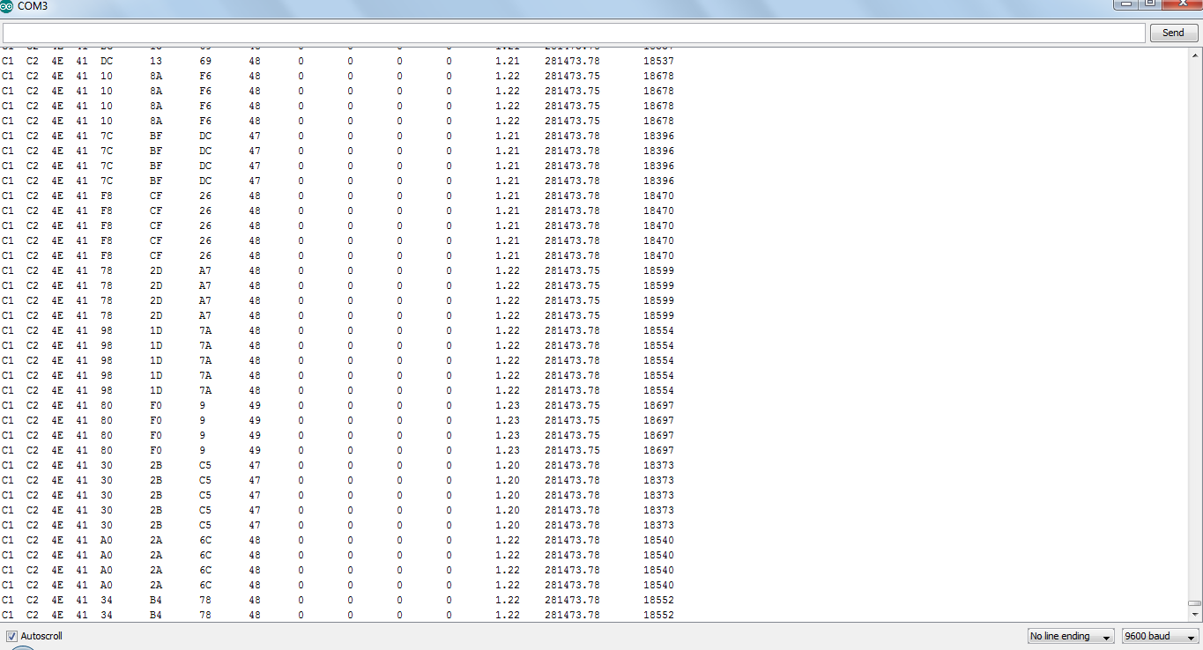
Output Example

Slide 6
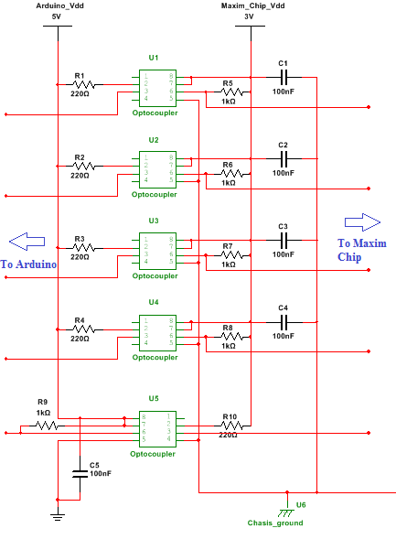

Slide 7
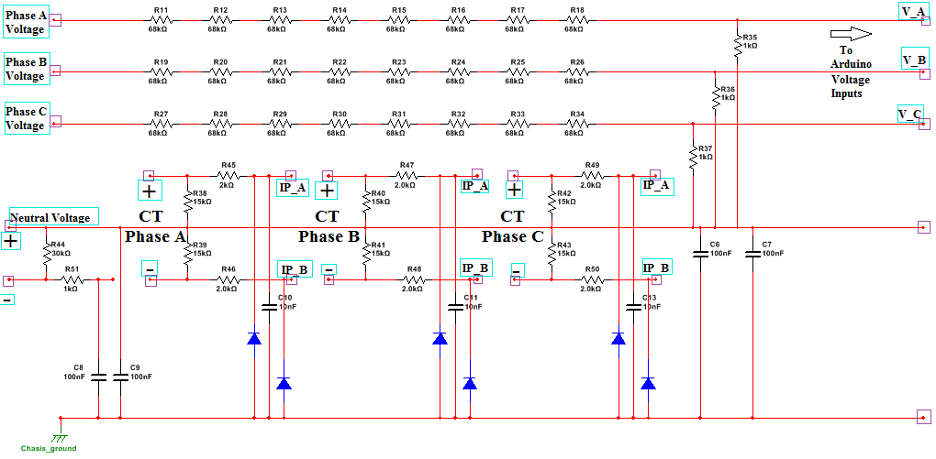

Slide 8
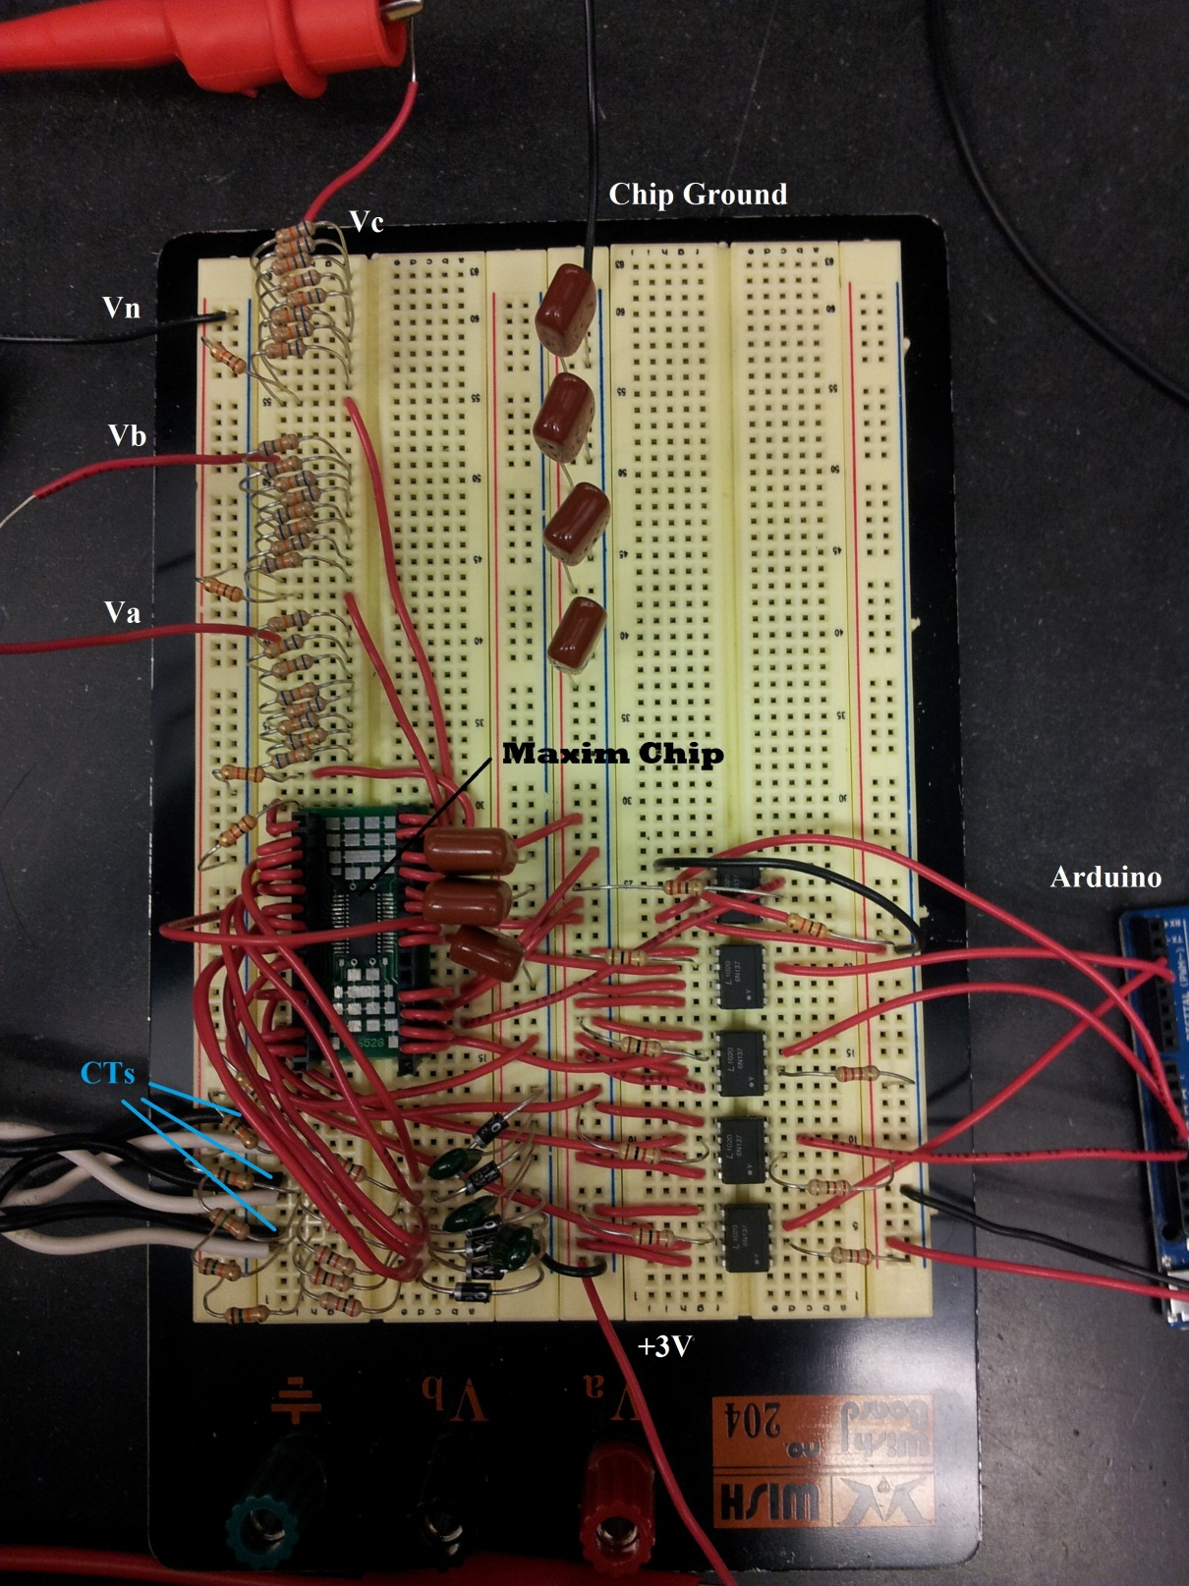

Slide 9
Work Breakdown
Sampling circuitry is complete
Able to read Voltage, Current, and Power measurements on all three phases simultaneously
Harmonic measurements are also available
Interface between the Maxim chip and Arduino is almost complete (Code for reading and writing registers is complete, circuitry is noisy)

Slide 10
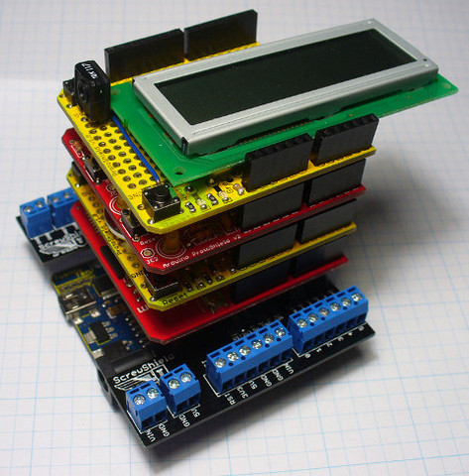
Upcoming Objectives
Waiting for new parts (crystal oscillator for a better clock)
Improve circuitry between the chip and Arduino to reduce noise
Determine power management for the entire device
Jack: Designing the custom PCB board
Sara: Figuring out the interface between the Arduino and the Cloud through the Wi-fly Shield

